Slide 1

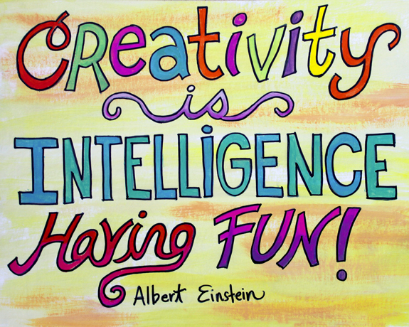
Unit 11
Intelligence and creativity

Slide 2
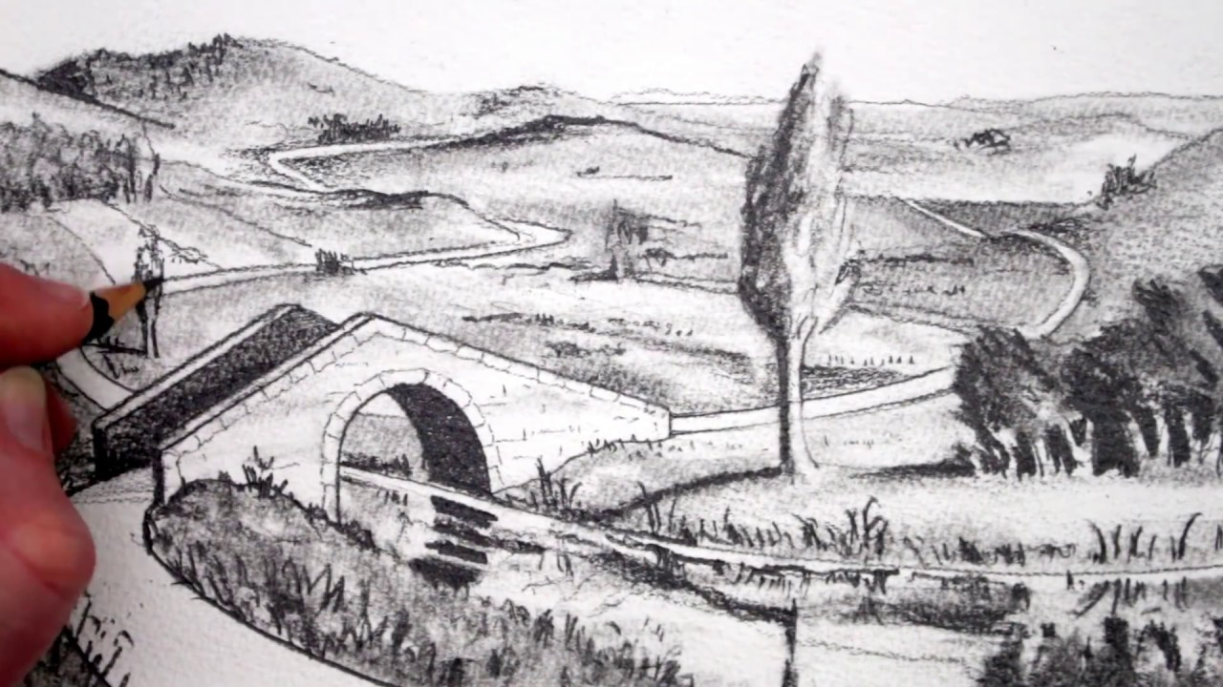


intended
purposed, expected, designed or planned

Slide 3

Creativity is using your imagination to create something original.

Slide 4
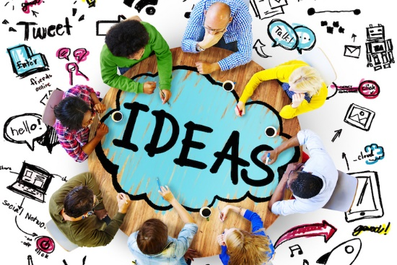
original
existing since the beginning

Slide 5
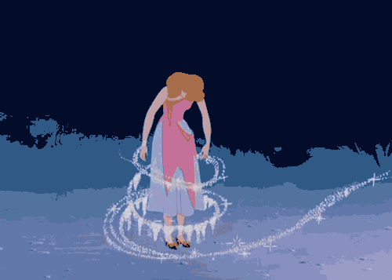
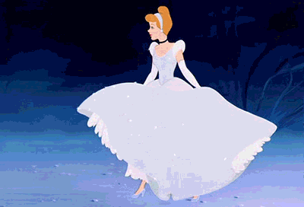
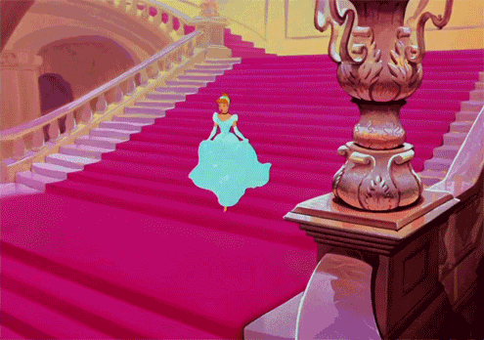
Walt Disney is creative. His drawings are so dramatic.

Slide 6
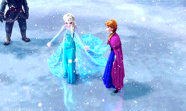
dramatic
very sudden or noticeable; or full of action and excitement

Slide 7
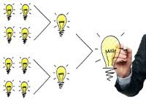
If you combine two or more different things, they begin to exit or work together.

Slide 8



We can combine the handle and the door together to open the door easily.

Slide 9

combine computer + network = Internet

Slide 10
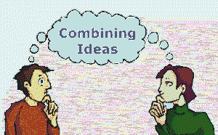

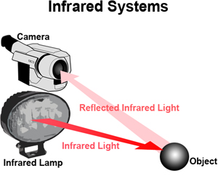
combine
to join together

Slide 11
involve
to make necessary

Slide 12
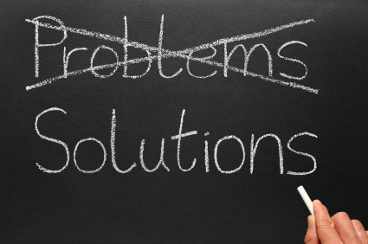
Focusing on solutions rather than problems is a great approach.

Slide 13

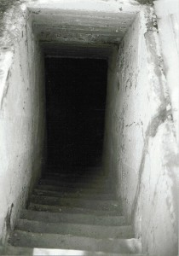

Approach
a way of doing something

Slide 14
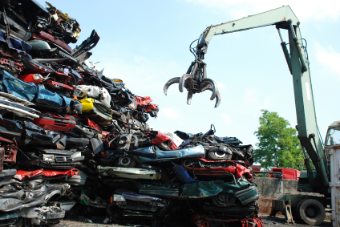
It’s a creative approach to take the old cars away for recycling.

Slide 15

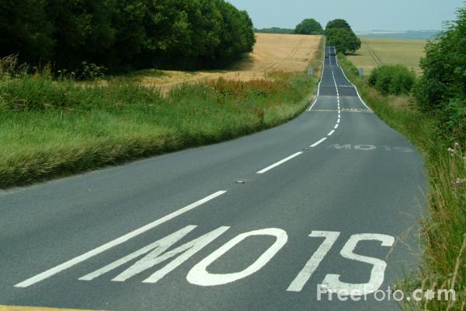
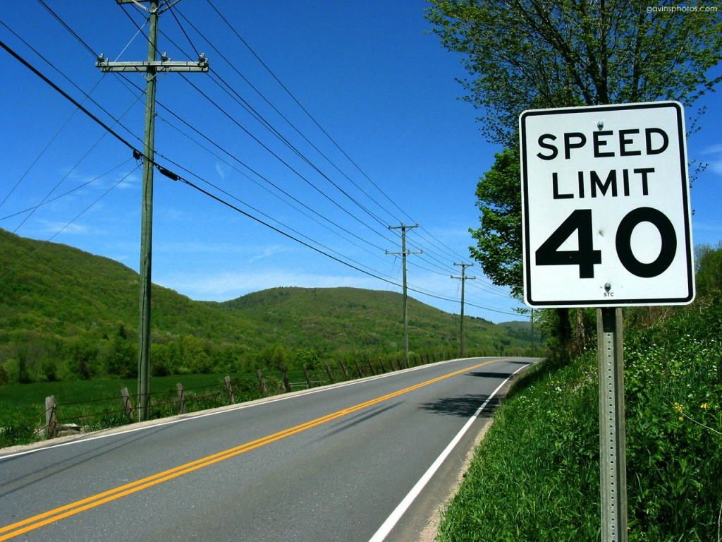
Most city planners slow traffic down with speed restrictions and signs.

Slide 16
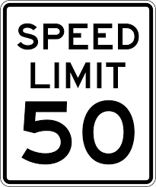
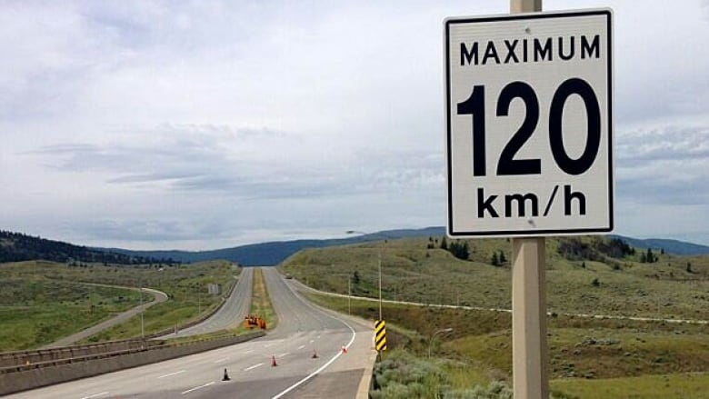
restriction
an official limit on something

Slide 17

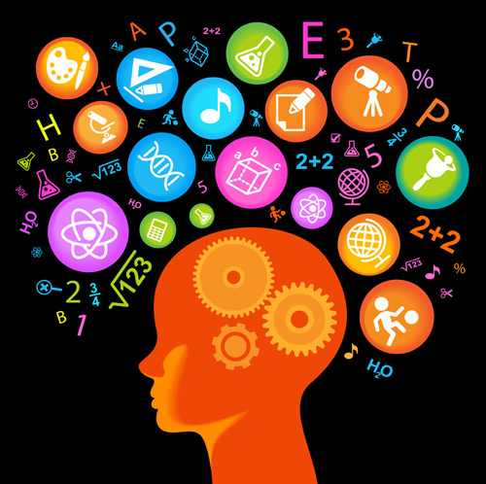
New Vocabulary

Slide 18
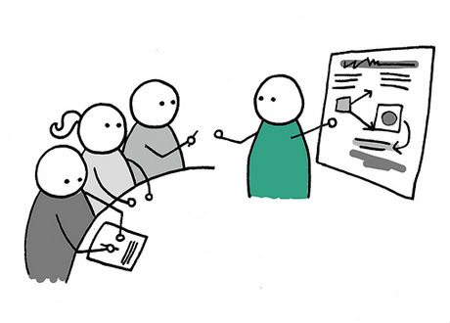




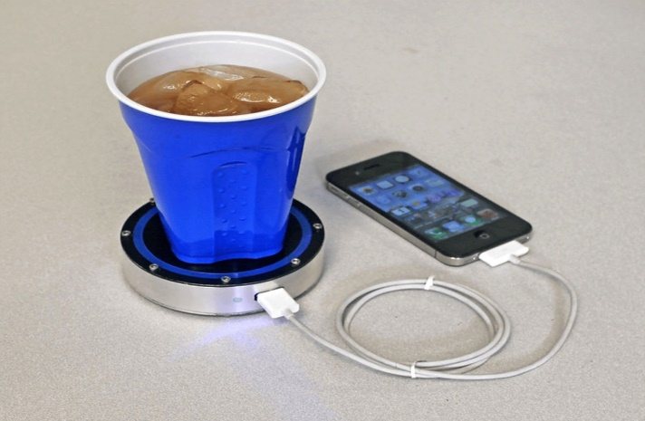

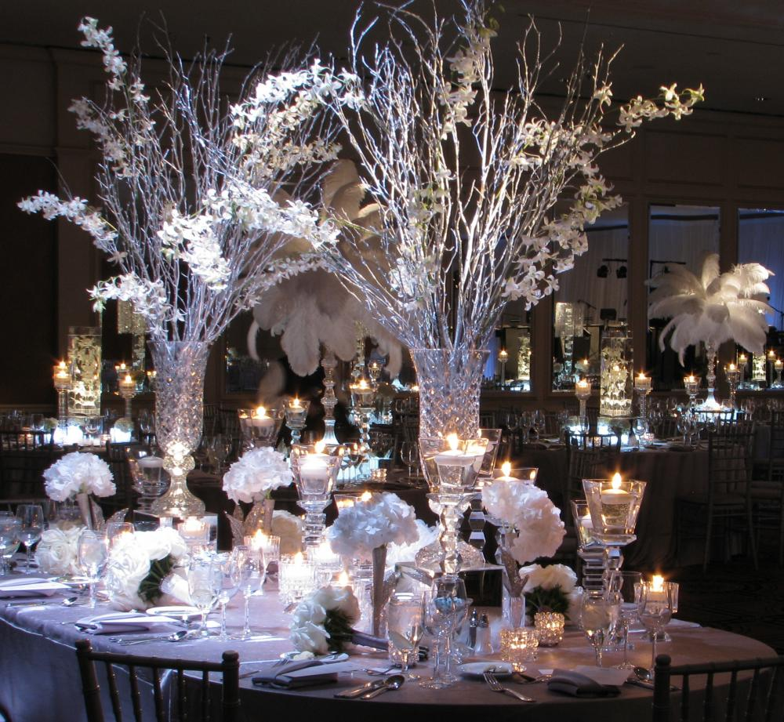
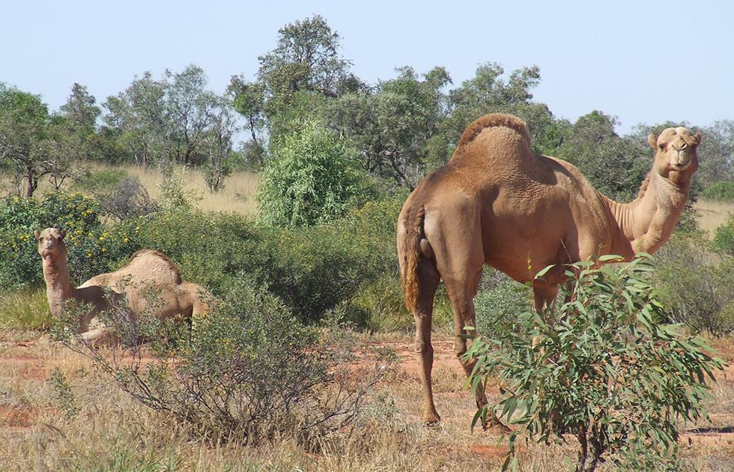


intended (adj.)
original (adj.)
dramatic (adj.)
combine (v.)
involve (v.)
approach (v.)
restriction (n.)
existing since the beginning

Slide 19
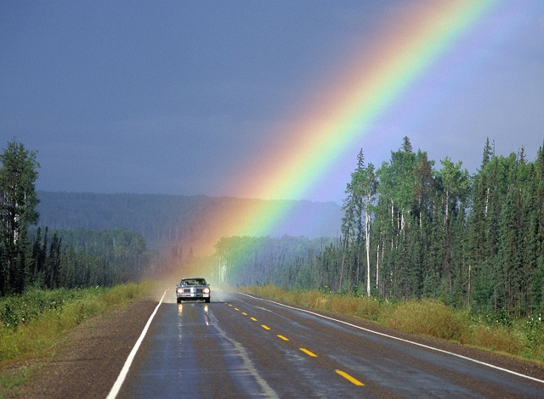

Student’s Book
Page 83

Slide 20

Creativity is using your imagination to create something original. Everyone is creative, but some people act on their ideas and others don’t.
There are many ways of being creative and creativity can help us solve many different
problems.

Slide 21
What is the purpose of the text?

Slide 22

Thank you

